Slide 1
Smart In-Campus Car Parking System

Slide 2
Problem Statement
IOT02: Smart In-Campus Car Parking System Due to the increase in traffic on the national highway, it is difficult to reach the campus on time, and finding the nearest parking space for four-wheeler parking is tedious. Develop an intelligent application that provides a real-time parking slot within the campus as soon as the car enters the main gate. The empty parking space should be messaged to the user’s mobile whenever a person enters through the main entrance. Make sure initially, every car owner has to get registered with the APP and the APP gets activated once the car enters the main gate and the nearest available parking slot is assigned. Assuming that users must choose the building they work at during registration. The application should provide an empty parking slot near their chosen building.

Slide 3
OUR SOLUTION
Sometimes it becomes difficult to reach the campus on time, and finding the nearest parking space for four-wheeler parking is tedious. To Counter this we devised an IOT based strategy in which we provide the user the nearest available parking slot to their respective working building as soon as they reach gate. First all users data are stored in a database. We continuously monitor the various parking area status through upheld cameras and sensors. Whenever a user reach the gate, the RFID extract data of that user and then send it to the campus parking server. The server on the basis of available real time parking slots data allot him/her a parking slot nearest to their building.

Slide 4
Data Acquisition:
Receiving data of different parking places through various overhead cameras and sensors to get the status of parking slots
Car enters the campus gate. The RFID scanner in the campus gate scans the tag on car windshield to get authenticity and information of the car owner.
Sending data to receiver block to activate it
Central Server System
Data Block:
It keeps records of all available and engaged parking slots in real time and provide data for the same.
Receiver Block:
The server system receives the information of user and preferred parking area(near the building where they work).
Requesting data
Sending parking status
data
Sending data to processing block to activate it
Processing Block:
The processing unit after getting user data from receiver block sends a request to data block to access the real-time parking status and then process it according to user needs to allot him/her a suitable parking slot near their building.
The allotted parking slot is messaged on the smartphone of the user based on the data received by the RFID

Slide 5

Presentation of the Solution through simulation
For the purposes of demonstration of the provided solution,
we will be using Gazebo Stimulation
About Gazebo –
Gazebo is an open-source 3D robotics simulator. It integrated the ODE physics engine, OpenGL rendering, and support code for sensor simulation and actuator control. Gazebo can use multiple high-performance physics engines. used by industry and academia that calculates physics, generates sensor data and provides convenient interfaces. Gazebo helps you integrate a multitude of sensors, and it gives you the tools to test these sensors and develop your robots to best use them.

Slide 6
Multiple api used
rfid-reader open-source implementation on github – This API extracts the user information from the database of the tag that is identified.
Zebra RFID Reader SDK for Android
OpenCV and Image Processing APIs and transfer of data from cameras to the on ground control station or processing unit. (global master)
Database Management System APIs for manipulation of user information and parking spaces status.

Slide 7
MOBILE APPLICATION
The end product of the implementation will be available to the user as a mobile application.
On the mobile app, the user has to register themselves where they will be provided with unique RFID tags which have to be placed on the cars to be identified and allotted a parking slot.
The user details would include employee details, as well as car details and would provide a complete history of entry and exits of the user in the parking space.
The app interface is user friendly.

Slide 8
Ui/ux OF THE APPLICATION
T

Slide 9
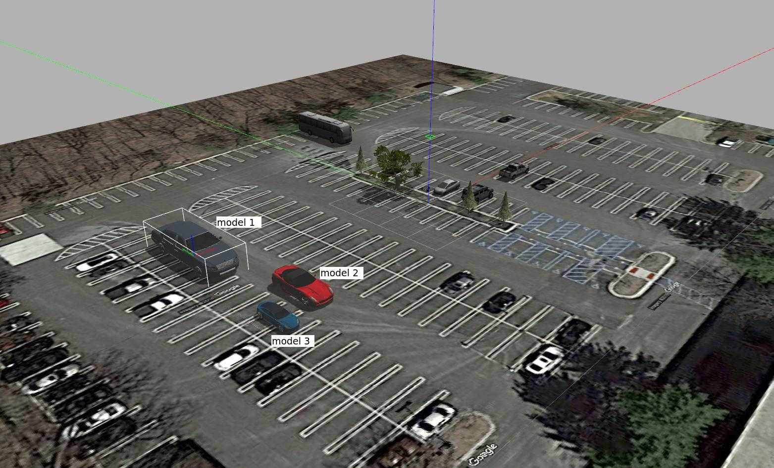
Simulation world
For the purpose of presenting our simulated world we would be demonstrating our solution in the form of this digital twin.
The algorithms for RFID sensor and detection along with the extraction of information for the corresponding user from the backend will be provided, such that once the car enters the campus, the details will be send from the integrated API, which will be visible on the front board on the entry point as well.
After getting the parking slot, the car has to drive to the point on the parking slot. There will also be different buildings in the simulation world to allocate parking slots near the building where the driver works.

Slide 10
Algorithms used at different stages of the process
For the purpose of getting the current state of the parking area different cameras will be used which are generally installed in the parking facilities.
The data coming from the cameras are sent through a secured cyber physical computer vision algorithm to detect all the parking slots whether engaged or vacant.
After getting the list of our vacant parking slots from all the cameras the data is sent to the database in real time

Slide 11
Algorithms used at different stages of the process
Once car enters the area – Car detection and Radio-frequency identification reading using the chip installed on each car.
Database management allocating the best available parking slot for the user
IOT enabled service for sending the slot details of the parking on the mobile number of the user. The same would be displayed on the screen near the entrance.
After driver once reaches the driving spot, the database updates the status of the available parking slots.

Slide 12
Real life impact of our solution
The provided solution would enable seamless, autonomous management and flow of all the cars in the parking space.
Information about each car present in the parking space at the user level.
Since this is a core cyber physical system, security will be maintained at the highest level.
Enhancing the parking space security as each user will be informed whenever his car leaves the parking area.
Extending the current implementation would also allow the users to prebook their parking slots if available.
All this would lead to a highly efficient and optimized management system as a whole.

